Slide 1


Pocket Roster
Login
Create Account

Slide 2




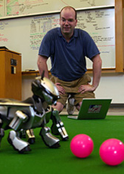





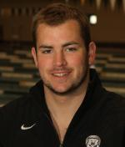
Search….
Eric Chown
Teams
Teams
Following
Swimming & Diving
3
Men
or
Women
Log Out

Slide 3
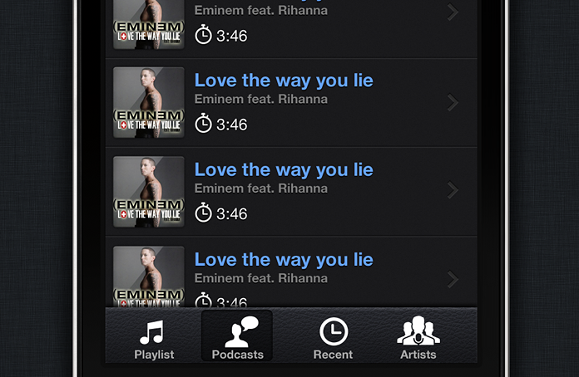
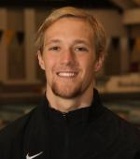
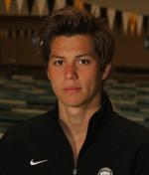
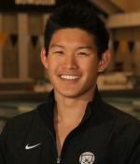
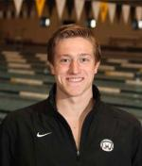
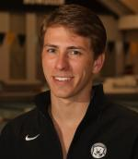
Roster
Roster
Basyl Stuyvesant
Hugo Tran
Will Shii
Ryan Kulesza
EJ Googins
Tom Kramer
Basyl Stuyvesant
Hugo Tran
Will Shii
Private & Confidential

Slide 4

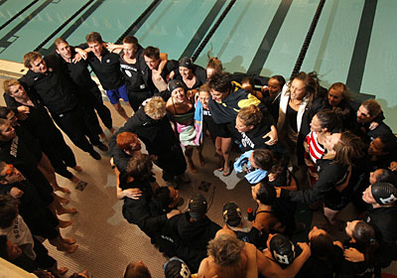
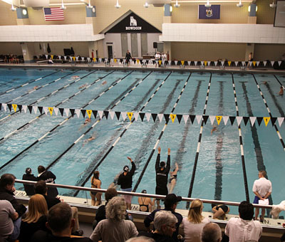
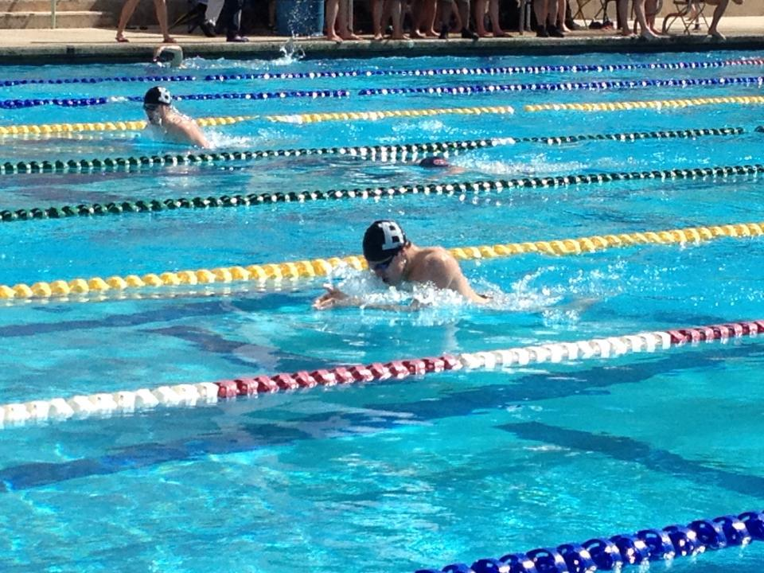
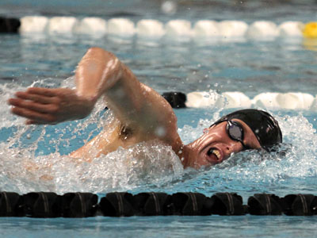
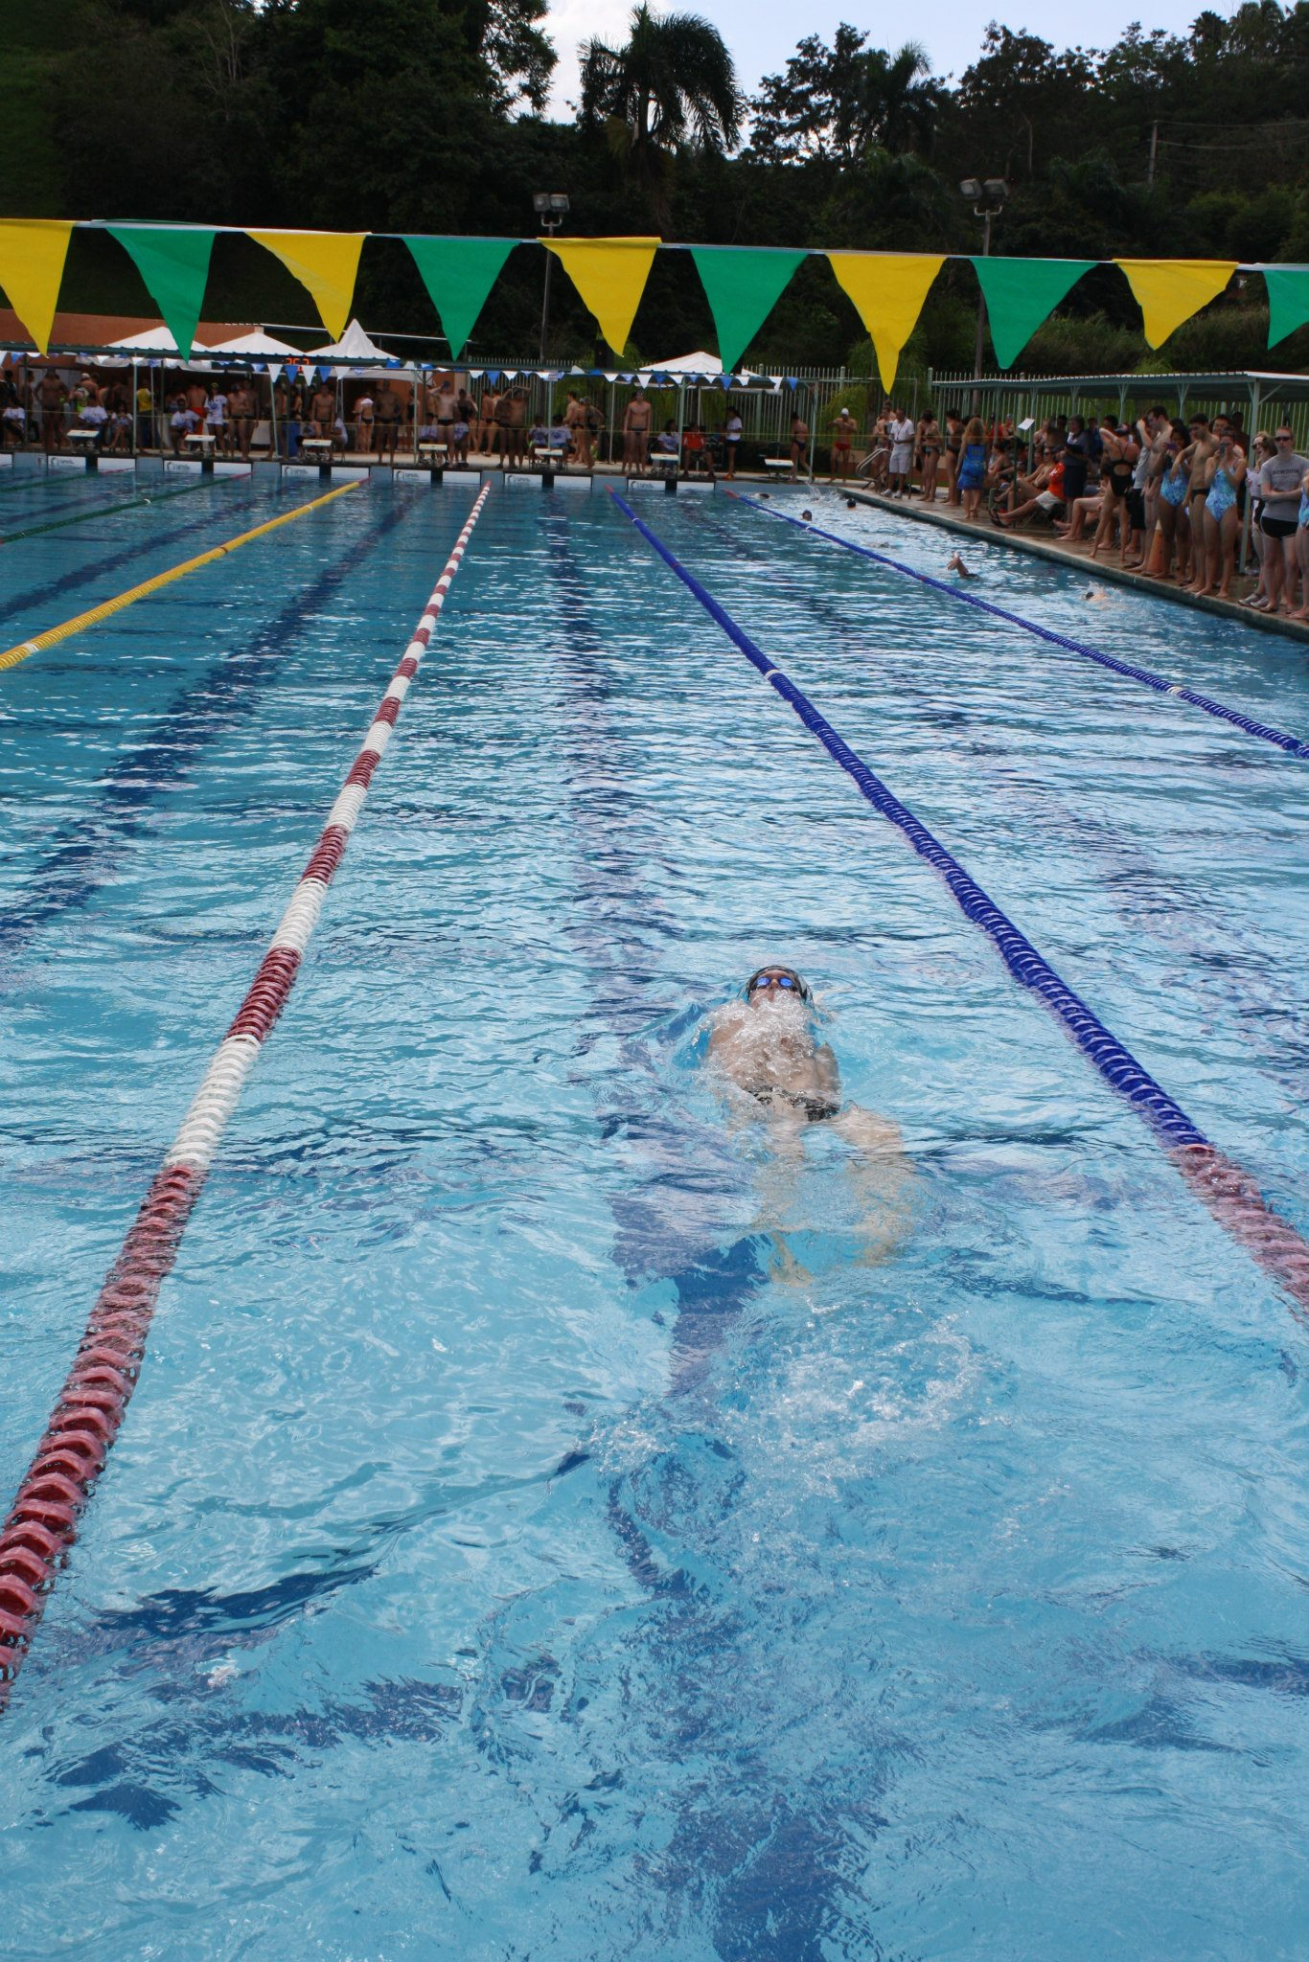
Roster
Ryan Kulesza
Class: 2015
Event: 200IM
From: Bethesda, MD
High School: Waldorf
Results

Slide 5

Finish
Four Weeks from Now:
Setup a Tagging System for Pictures (and stats)
Setup uploading system for the Flicker account through the app
Setup Search Bar
Final Week:
Debugging
Have Met With:
Professor Chown
Coach Burnham
Athletic Director Tim Ryan
I AM ARE HERE
Over the Next Two Weeks:
Get the the information from athletic site into the app
Create Flicker Account
Get Flicker code to access the album
Setup Concept

Slide 6
The End

